Slide 1
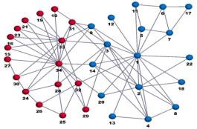
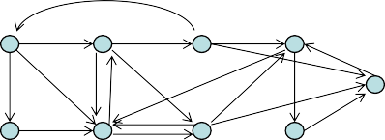
Graphs (Networks)
A graph is comprised of nodes (a.k.a. vertices) and edges. Each edge joins a pair of vertices.
– Typically n is the # of nodes and m is the # of edges, so a running time for a graph algorithm might be something like O(m log n).
Graphs can be either undirected or directed; by default “graph” == “undirected graph”.
Graphs are extremely common and versatile objects in CS due to their broad modeling capability.

Slide 2
Graph Types
Graph theory is a branch of mathematics that studies properties of graphs.
Some simple examples of special classes of
graphs we tend to see include:
The path (P_{n})
The cycle (C_{n})
The complete graph (K_{n})
Trees and forests
Bipartite graphs
Planar graphs
customers purchases

Slide 3

Graph Representation
Two common ways to represent a graph:
– An adjacency matrix (good for small, dense graphs)
1
1 2 3 4
1 0 1 0 0
2 0 0 1 0
3 1 0 0 1
4 0 0 1 0
2 3 4
– Adjacency lists (ideal for large or sparse graphs)
1
2 3
1: 2 3
2: 1 3 4
3: 1 2 4 5
4: 2 3 5
5: 3 4
4 5
Unless otherwise stated, we’ll assume our graphs are represented using adjacency lists.

Slide 4
Simple Graph Problems: Connectivity
Are nodes i and j connected by some path?
Example: wolf-goat-cabbage, water jugs
If so, determine such a path.
In a digraph, is there a directed path from i to j?
Does a (directed) graph have a (directed) cycle?
Partition a graph into its connected components.
Example: finding connected regions in USA map
For a digraph, we might want to find “strongly” connected components (x and y are “strongly” connected if there is a directed path from x to y and vice versa).
We can answer all of these in linear time, O(m+n) (often written just O(m)) using variants of depth-first search.

Slide 5
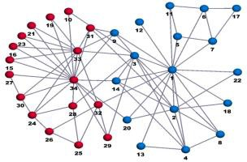
Some Classical Graph Problems
[Shortest Paths]: Find the shortest path between two nodes, or from one node to all other nodes.
[Minimum Spanning Trees]: Find a min-cost subset of edges that connects together all nodes.
[Matchings]: Pair up as many nodes as possible, or pair up all nodes at minimum total cost (often in a bipartite graph).
[Flow / Routing]: Route a maximum amount of some commodity through a capacitated network,
possibly at minimum total cost.
A B
7
19
10
8
15
9
12
11
2
4
16
14
3

Slide 6
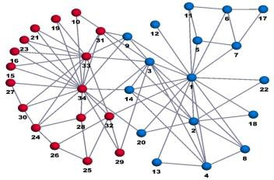
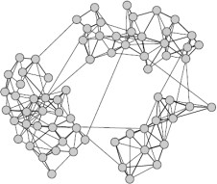
Network Analysis / Data Mining
[Similarity / Connectivity]: How similar are nodes X and Y if edges connect directly-related elements?
[Clustering]: Does a graph break naturally into several large “clusters”?
[Centrality]: Find nodes that are well-connected with all other nodes.
customers purchases
X
Y

Slide 7
Depth-First Search (DFS)
DFS-Visit(i): Status[i] = ‘visited’
For all j such that (i,j) is an edge: If Status[j] = ‘unvisited’:
Pred[j] = i
DFS-Visit(j)
Full-DFS:
For all i: Pred[i] = null, Status[i] = ‘unvisited’ For all i: If Status[i] = ‘unvisited’: DFS-Visit(i)
Works in undirected and directed graphs.
Full-DFS takes O(m + n) time since it spends O(1) time on each node and edge.

Slide 8

Depth-First Search (DFS)
Full-DFS gives us an easy way to partition an undirected graph into its connected components.
The pred[i] pointers define what is called a depth-first search tree (regard as parents)
To find a path from i to j:
call DFS-Visit(i)
Follow pred pointers backward from j to I (this follows path
in reverse)
1
2
pred[j] = 4
i
j
3
4

Slide 9
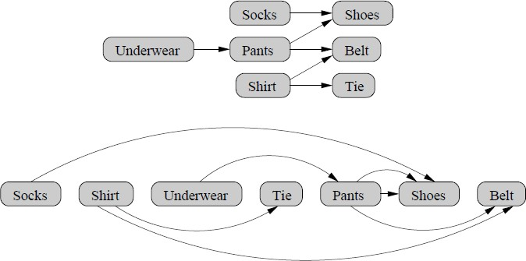
Topological Sorting
Directed Acyclic Graphs (DAGs) are often used to model systems with “precedence” constraints.
Topological sorting is the process of ordering the nodes of a DAG so all edges point a consistent direction.

Slide 10
Topological Sorting
There are several ways to topologically sort in O(m + n) time; for example:
Find a node with no incoming edges, add it next
to the ordering, remove it from our graph, repeat.
If we ever find that every node has an incoming edge, then our graph must contain a cycle (so this gives one way to do cycle detection).
Depth-first search gives us another very simple (reverse) topological sorting algorithm: do a full DFS, printing each node at the end of the DFS-visit() function.

Slide 11
Types of Shortest Path Problems
Single-source single-destination: find the shortest path from s to t in a (directed) graph.
Single-source: find the shortest path from s to every other node in a (directed) graph.
All-pairs: find the shortest path from every node to every other node.

Slide 12

Single-Source Shortest Paths
 |  | 1 | 11 | 2 | Input: Directed graph with costs/weights/lengths on ⁵ its edges. Output: c[j]: cost of shortest s → j path pred[j]: previous node (before j) on a shortest s → j path. 5 c[5] = 15 “Shortest path tree”
 | 9 |  |  | 12
s |  | 4 | 3 | 5
 | 2 | 3 | 1 8 | 6 4
 |  | c[1] = 6 1 | 11 | c[2] = 17 2
s |  | 4 | 3 | pred[5] = 4
 | 2 |  |  | 6
 |  | 3 |  | 4
 |  | c[3] = 2 |  | c[4] = 9

Slide 13
Single-Source Shortest Paths: Algorithms
Cases that we can solve in linear time; O(m)
Unweighted graphs: use breadth-first search.
Directed acyclic graphs (DAGs): topological sort, then one pass over graph to find shortest paths.
If edge costs are nonnegative, we’ll use
Dijkstra’s algorithm; O(m log n)
If some edge costs are negative, we use the
Bellman-Ford algorithm; O(mn)

Slide 14
Breadth-First Search
BFS(s):
For all nodes i: pred[i] = null dist[i] = Infinity
Q = {s}
dist[s] = 0
While Q is nonempty:
i = next node in Q
For all nodes j such that (i,j) is an edge: If dist[j] = Infinity,
pred[j] = i
dist[j] = dist[i] + 1 Append j to the end of Q
Visits a graph “layer by layer”.
If Q is implemented as a stack rather than as a FIFO queue, we get DFS rather than BFS!

Slide 15
Negative-Cost Cycles
If negative-cost edges exist:
We need to use the O(mn) Bellman-Ford algorithm.
We can only find shortest paths if there are no negative- cost directed cycles (Bellman-Ford can at least detect whether negative cycles exist).
If our graph is undirected, we typically assume it has no negative-cost edges to begin with.
Longest path problems convert to shortest path problems by negating edge lengths, so positive- cost cycles are bad for these problems
So longest path problems are rarely tractable, since most graphs have positive-cost cycles.
Except DAGs, that is…

Slide 16
Dijkstra’s Algorithm
Dijkstra:
c[s] = 0, c[j ≠ s] = +∞ While Q is nonempty:
Find yet-unvisited node i having minimum label c[i]
(e.g., using a priority queue or set; at this point we know c[i] is correct)
For all edges (i, j) outgoing from i:
If c[i] + cost(i, j) < c[j], “remove slack” from (i,j)
c[j] = c[i] + cost(i, j) pred[j] = i
Note similarity to BFS; essentially uses a priority queue instead of a queue.
Running time depends heavily on priority queue:
– n remove-mins, at most m decrease-keys
Using a binary heap, all these operations run in O(log n) time, so total is O(m log n).

Slide 17
Dijkstra’s Algorithm – Example
+∞ 1
+∞ 2
11
9
12
3
0 s
4
5
5 +∞
2
1
8
6
3
+∞
4
+∞
Initialization – all cost labels infinity except the source, set to zero. We’d like to improve the cost labels of all nodes so they reflect the costs of shortest paths.

Slide 18
Dijkstra’s Algorithm – Example
9
1
+∞ 2
11
9
12
3
0 s
4
5
5 +∞
2
1
8
6
3
2
4
+∞
Examine the source node s, so s becomes “permanently” labeled.
Tighten all edges leaving s.

Slide 19
Dijkstra’s Algorithm – Example
6
1
+∞ 2
11
9
12
3
0 s
4
5
5 +∞
2
1
8
6
3
2
4
10
Examine node 3, which becomes permanently labeled.
Tighten all edges leaving node 3.

Slide 20
Dijkstra’s Algorithm – Example
6
1
17
2
11
9
12
3
0 s
4
5
5 +∞
2
1
8
6
3
2
4
9
Examine node 1, which becomes permanently labeled.
Tighten all edges leaving node 1.

Slide 21
Dijkstra’s Algorithm – Example
6
1
17
2
11
9
12
3
0 s
4
5
5 15
2
1
8
6
3
2
4
9
Examine node 4, which becomes permanently labeled.
Tighten all edges leaving node 4.

Slide 22
Dijkstra’s Algorithm – Example
6
1
17
2
11
9
12
3
0 s
4
5
5 15
2
1
8
6
3
2
4
9
Examine node 5, which becomes permanently labeled. Tighten all edges leaving node 5 (there aren’t any).

Slide 23
Dijkstra’s Algorithm – Example
6
1
17
2
11
9
12
3
0 s
4
5
5 15
2
1
8
6
3
2
4
9
Examine node 2, which becomes permanently labeled.
Algorithm terminates!

